Slide 1


Titolo presentazione sottotitolo
NON SOLO LIBRI
Design and Implementation of Mobile Applications project 2018-2019
Milano, XX mese 20XX
Matteo Colombo - 883114
Andrea Troianiello - 898113

Slide 2
Description of the application
Three main functions:
Manage libraries
Social network
Market place
Multiple language
English
Italian
Ready for other languages
Client-Server system:
Flutter
Firebase
Notes:
As seen in the video, the application is a small social network and its main function is to organize the libraries of a user by allowing him to personalize them and to add books.
To achieve this we designed a client-server system.
The application is multi language: more precisely English and Italian are supported and is ready for other languages.

Slide 3

Server - Firebase
The server is implemented using Firebase, a development platform that allows to implement easily the backend and to manage a NoSQL database (a document-oriented type)
Notes:
To simplify the development of the server we used Firebase, so that we could focus on the application without having to worry too much on security, reliability and in implementing a fully functional back end.

Slide 4




Components of Firebase
Cloud Firestore
Cloud Storage
Functions
Authentication
Notes:
The main component of Firebase that we used are Cloud Firestore, a NoSQL database that supports real time messages to the client via push notifications.
Cloud Storage, which we used to store images of the books and of the libraries.
Functions, which are simple functions triggered when a CRUD request is performed on the database and that helped us in cleaning up and syncing the database.

Slide 5
Client
Contains most of the logic of the system
Designed with a Bottom-up approach
Model is implemented using the database first approach
Core of the application independent from external libraries and hardware
Notes:
The application is obviously the client and contains most of the logic of the system.
It was designed with a bottom up-approach and the model is implemented using a database first approach.
We started to design the database and then we implemented the application around that.

Slide 6
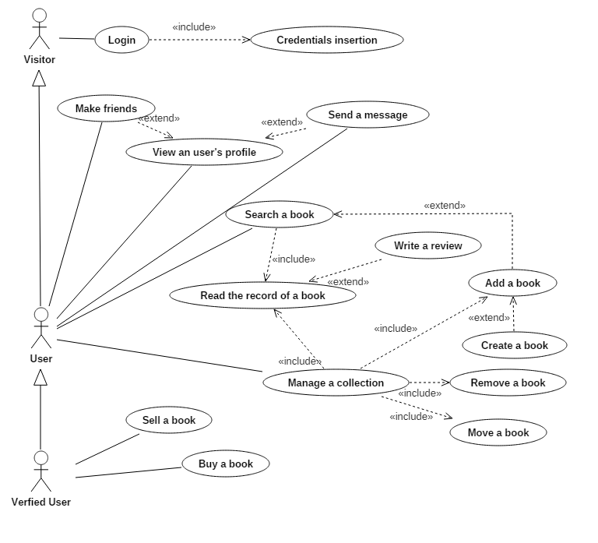
Use case diagram
Notes:
During the design we identified three types of users.
A visitor who is a user that has yet to log in the application and that’s is the only action that he can perform.
A user, who is a person who logged in the application and can make use of the main functionality of the application such as creating a library, searching for a book and to add books to his libraries.
A verified user, who is a user that verified his identity and can now access to the market place of the application where he can buy and/or sell books.

Slide 7

Flutter
Flutter is used during the implementation of the application
Natively compiled
Cross-platform
Notes:
Talking about the application, it was developed with Flutter.
This helped us with the cross-platform design and even if the application was developed and tested only on android, it is compatible with ios and we would need only some modifications to make it run.
We chose flutter because it is compiled natively and it guarantees great performances.

Slide 8
Testing
Each component of the core is tested using native tools provided by Flutter
There are three types of tests on Flutter:
Unit test
Widget test
Integration test
To simulate external libraries we used Mockito.
In addition, extensive tests were made by real users, by testing the application in daily conditions with both physical devices and emulators
Notes:
During the implementation we tested most of the pages that were implemented by using the flutter native tools for testing.
We made unit tests for the model, while for the widgets - that represent the various components in flutter - we made widget and integration tests.
All the test were followed by an extensive testing phase performed with real devices and emulators by multiple persons.

Slide 9
Contacts
Matteo Colombo
matteo32.colombo@mail.polimi.it
Andrea Troianiello
andrea.troianiello@mail.polimi.it

